Slide 1

SCHOOL MANAGEMENT SYSTEM PROJECT
PRESENTATION BY :-
SOHAM MAITY – XIi-A
VEDANT SHARMA – xii-a

Slide 2
About the project…..
The title of the project is “School Management system”. This project will handle whole the activities of the school. SMS has most of the facilities that a modern school requires to computerize its day-to-day jobs. It provides facilities to keep the records of student, fees, teaching and non-teaching staff with all their required details along with all required transaction handling. It has facilities to generate various types of reports, which are required by the management during normal business operations to operate the business effectively.

Slide 3
This project is based on the PYTHON CONSOLE BASED; the main objective of this project is to computerize the manual system & reduce the time consumption . In other words we can say that our project has the following objectives:-
 Make all the system computerize
 Reduce time consumption
 Reduce error scope
 All system managements are automated
 Centralized database management
 Easy operations for operator of the system
 No paper work requirement

Slide 4
NAME OF REPORTS
Following are the reports names that are generated by the Project for the management of school or staff members of the school.
Details of Teaching staff.
Details of non-teaching staff.
Class wise detail of students.
Date wise detail of students based on date of admission.
Teacher report based on the Date of joining.

Slide 5
DATA FLOW DIAGRAM

Slide 6
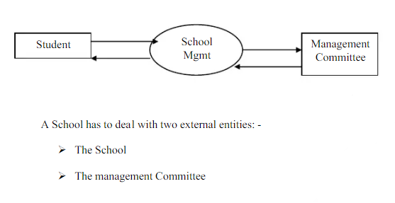
Level 0

Slide 7
SCHOOL MANAGEMENT SYSTEM
LEVEL 1
ADMIN LOGIN
TEACHER SALARY STRUCTURE
STAFF SALARY STRUCTURE
STUDENT
SCIENCE
COMMERCE
ARTS
DATABASE
STUDENT ADMISSION DETAILS
STUDENT REPORT CARD
STUDENT FEE STRUCTURE

Slide 8
TEACHER SALARY STRUCTURE
LEVEL 2
SCIENCE
ARTS
COMMERCE
B.Sc/BA/B.Com
M.Sc/MA/M.Com
PHD
* B.ed compulsory
1. Insert teacher details
2. Compute teacher salary details
3. Display teacher records
4. Append teacher details
5. Search teacher record
6. Update teacher details
7. Delete teacher record
8. Display particular teacher record
Teacher's Name
Teacher's Teaching Subject
3. Teacher's Qualification(degree)
4. Teacher's Grade
5. Teacher's Gender
6. Teacher's Date of Birth (DD/MM/YYYY) 7. Teacher's Phone number
8. Teacher's Email Address
Teacher's House Address
* Teacher ID will be automatically given by the system(ERP software)
PRT
TGT
3. PGT

Slide 9
STAFF SALARY STRUCTURE
LEVEL 3
B.Sc/BA/B.Com
M.Sc/MA/M.Com
PHD
Staff's Name
Staff's Teaching Working Subject
3. Staff's Qualification(degree)
4. Staff's Grade
5. Staff's Gender
6. Staff's Date of Birth (DD/MM/YYYY) 7. Staff's Phone number
8. Staff's Email Address
Staff's House Address
* Staff ID will be automatically given by the system(ERP software)
1. Insert staff details
2. Compute staff salary details
3. Display staff records
4. Append staff details
5. Search staff record
6. Update staff details
7. Delete staff record
8. Display particular staff record
RECEPTIONIST
CLERK
3. OFFICE ASSISTANT
4. HEAD CLERK
5. OFFICE SUPERINTENDENT
6. DRIVER
7. GARDENER
8. SWEEPER
9. SECURITY

Slide 10
STUDENT FEE STRUCTURE
STUDENT
LEVEL 4
1. Student's Name
2. Student's Father's Name
3. Student's Mother's Name
4. Student's class
5. Student's Gender
6. Student's Date of Birth (DD/MM/YYYY)
7. Student's parents Phone number
8. Student's House Address
9. Whether the Student wants to avail for bus service
10. Enter the distance(in Km) between Student's House Address and School
11. Whether the Student wants to stay in school hostel
* Student admission number and house will be automatically given by the system(ERP software)
1. Insert student details
2. Compute student fee details
3. Display student records
4. Append student details
5. Search student record
6. Update student details
7. Delete student record
8. Display particular student record
YES/NO

Slide 11
STUDENT REPORT CARD
LEVEL 5
Insert student details
2. Compute student report card details
3. Display student records
4. Append student details
5. Search student record
6. Update student details
7. Delete student record
8. Display particular student record
1. Whether he/she attended the UNIT_TEST-1
2. Whether he/she attended the UNIT_TEST-2
3. Whether he/she attended the TERM-1 examination
4. Whether he/she attended the UNIT_TEST-3
5. Whether he/she attended the UNIT_TEST-4
6. Whether he/she attended the TERM-2
7. Class performance in percentage(out of 5%)
8. Project and activity percentage(out of 5%)
9. Marks of each and every subject
10. Grades obtained by the student in CCA
YES/NO

Slide 12
SCOPE OF THE PROJECT
Nothing is perfect in this world. So, we are also no exception. Although, we have tried our best to present the information effectively, yet, there can be further enhancement in the Application. We have taken care of all the critical aspects, which need to take care of during the development of the Project.
Like the things this project also has some limitations and can further be enhances by some one, because there are certain drawbacks that do not permit the system to be 100%accurate.

Slide 13
UTILITY OF THE PROJECT…

Slide 14
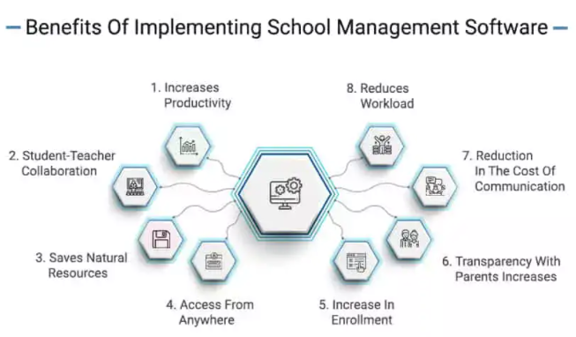
#1: Increases Productivity
The school management system boosts the productivity of the institute. The reason for the increase in productivity is decreased time to maintain the track records and increased accuracy in organizing the data. Less time leads to keeping the institute focused on the productivity of the school.

Slide 15
#2: Saves Natural Resources
Stationary right from the paper files to records is saved when the ERP system is used for performing routine administrative tasks. It leads to saving the natural resources and keeps a digital track of the data. Also it does not create a mess of the records to be maintained.
#3: Access From Anywhere
The software can be accessed from anywhere and at any time. A record of everything can be kept due to its easy accessibility. It also facilitates providing immediate information to all the stakeholders. All they require is the credentials of the online education ERP portal.

Slide 16
#4: Increase In Student Enrollment Ratio
Due to the hectic schedule of the organizations and the tough decision making policies, it becomes troublesome to check in with the enrollment ratio of the students. It is thus required to implement proper school software so as to reduce the burden from various activities. Features of the school management system such as analytics dashboard & reports generation lets the organization focus on increasing the students’ enrollment.
#5: Transparency With Parents Increases
The cloud based ERP software, leads to the interaction with the parents as well. Parents can check on their wards from time to time and keep a track of their advances in the academic fields. This leads to the transparency between the parents and the wards.

Slide 17
#6: Reduction In The Cost Of Communication
All the essential data is available on the software and hence there is a reduction in the cost of communication, which includes calling and sending out messages to let the parents and student know about the various activities within the institution.
#7: Reduces Workload
The workload upon the staff members is reduced as the teachers need to be technology driven. This leads them to work upon the ERP and send out the required data to the students and their parents over the system. It reduces the workload from the teachers and saves time.
In a nutshell, the advantages of a school management system are tremendous and cover all the areas of the organization. Right from administration department to teaching-learning, it helps in maintaining the best digital educational ecosystem.

Slide 18
THANK YOU!!!

